Slide 1

Data Description
Session 10
M. Kachour

Slide 2
Descriptive statistics – Bivariate
Goals :
The aim is to characterize the link (if any) between the data of two variables studied simultaneously on individuals of the same population ( or part of the population).
Remark :
The existence of the link between the data of two variables does not imply "causality" → a link that asserts that the data of one variable acts on the data of another
For example : a study showed a link between the number of rabbits in Australia and the Dow Jones index. However, it seems difficult to say that there is causality.

Slide 3
Note

Slide 4
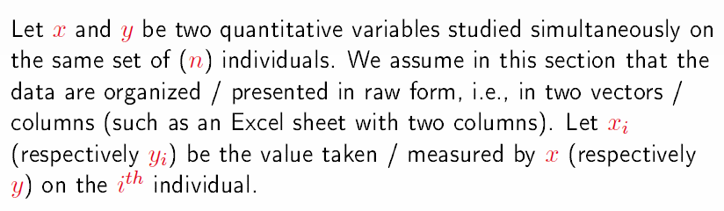
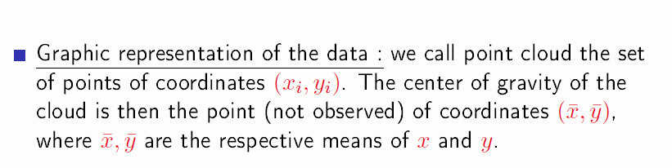
The case of two quantitatives whose data are presented in the raw state

Slide 5
Note

Slide 6
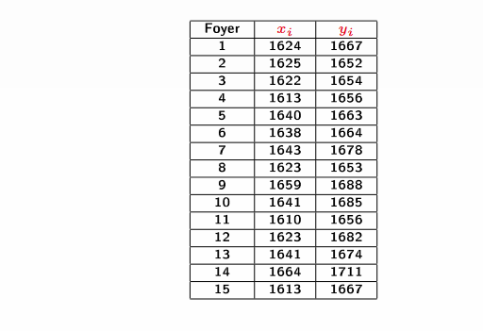


Example
Population: French households where men and women are active
Number of households studied = 15
The variables studied simultaneously on each household:
    Women's salary → $x$
    Man's salary → $y$
Goal : Evaluate the possible link between $x$ and $y$
The data :
$$\overline{x}=1631.993$$
&
$\overline{y}=1670$

Slide 7
Note

Slide 8
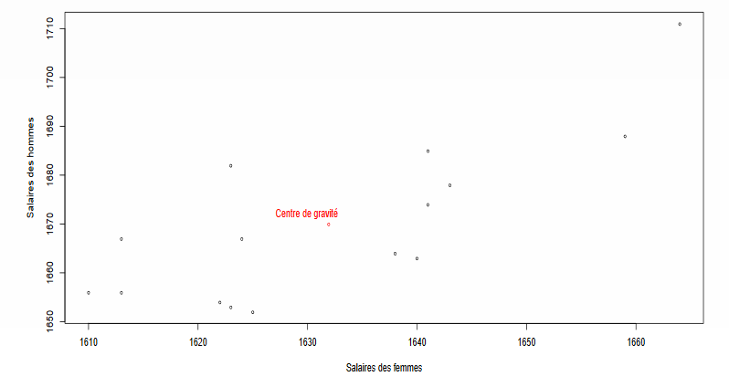
Graphical Representation – Scatter plot

Slide 9
Note

Slide 10


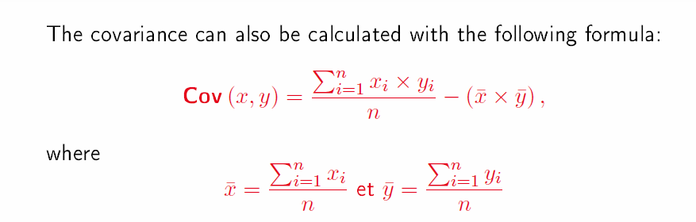
Calculation of the covariance
Covariance (the variance in common) is an indicator of the direction of variation of the two variables studied.
Covariance is noted
Formula for calculating covariance:

Slide 11
Note

Slide 12
Interpretation of covariance
If the covariance is strictly positive, then it can be deduced that the data of both variables vary in the same direction (in other words, if the data of one variable increase (resp. decrease) then the data of the other will have a tendency to increase (resp. decrease) too)
If the covariance is strictly negative, then it can be deduced that the data of the two variables vary in an opposite direction (in other words, if the data of one variable increase (resp. decrease) then the data of the other will have a tendency to decrease (resp. increase))
A zero covariance does not necessarily imply the absence of a link between the data of the two variables

Slide 13
Note

Slide 14
Back to example
Objective:
Calculate covariance
Comment on the result

Slide 15
Note

Slide 16

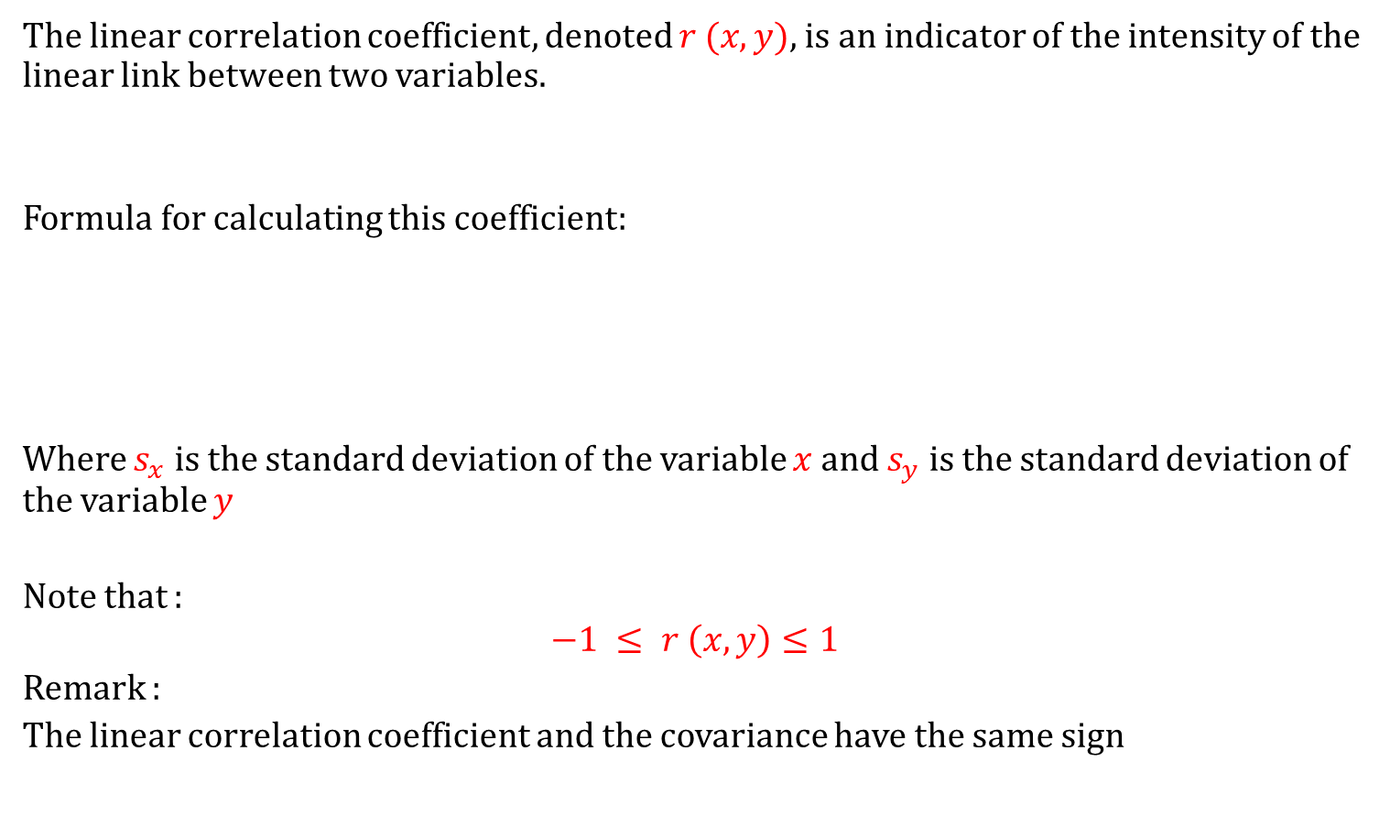
The linear correlation coefficient
The linear correlation coefficient, denoted $r (x, y)$, is an indicator of the intensity of the linear link between two variables.
Formula for calculating this coefficient:
Where $s_{x}$ is the standard deviation of the variable $x$ and $s_{y}$ is the standard deviation of the variable $y$
Note that :
$$−1 ≤ r \left(x, y\right)≤1$$
Remark :
The linear correlation coefficient and the covariance have the same sign

Slide 17
Note

Slide 18
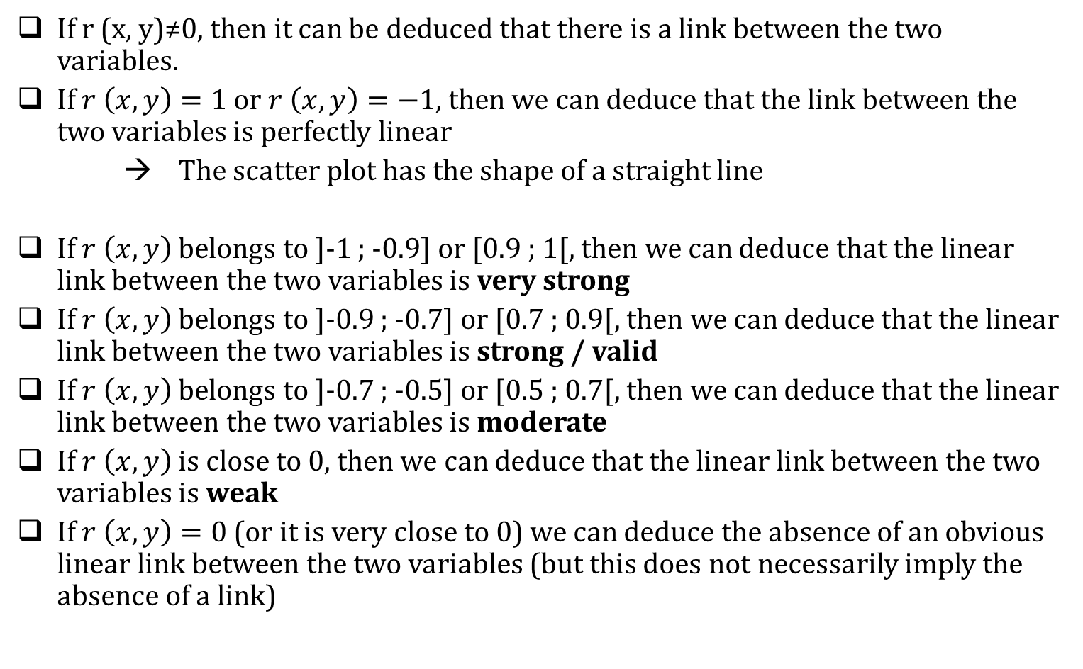
Interpretation - The linear correlation coefficient
If r (x, y)≠0, then it can be deduced that there is a link between the two variables.
If $r \left(x, y\right)=1$ or $r \left(x, y\right)=−1,$ then we can deduce that the link between the two variables is perfectly linear
→ The scatter plot has the shape of a straight line
If $r \left(x, y\right)$ belongs to ]-1 ; -0.9] or [0.9 ; 1[, then we can deduce that the linear link between the two variables is very strong
If $r \left(x, y\right)$ belongs to ]-0.9 ; -0.7] or [0.7 ; 0.9[, then we can deduce that the linear link between the two variables is strong / valid
If $r \left(x, y\right)$ belongs to ]-0.7 ; -0.5] or [0.5 ; 0.7[, then we can deduce that the linear link between the two variables is moderate
If $r \left(x, y\right)$ is close to 0, then we can deduce that the linear link between the two variables is weak
If $r \left(x, y\right)=0$ (or it is very close to 0) we can deduce the absence of an obvious linear link between the two variables (but this does not necessarily imply the absence of a link)

Slide 19
Note

Slide 20
Back to example
Objective:
Calculate the linear correlation coefficient
Interpret the results

Slide 21
Note

Slide 22
Note

Slide 23
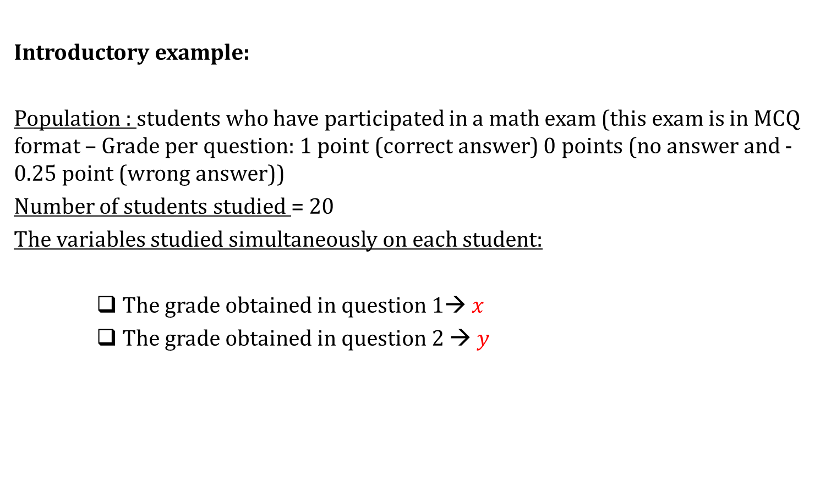
The case of two quantitatives whose data are presented in a contingency table
Introductory example:
Population : students who have participated in a math exam (this exam is in MCQ format – Grade per question: 1 point (correct answer) 0 points (no answer and -0.25 point (wrong answer))
Number of students studied = 20
The variables studied simultaneously on each student:
    The grade obtained in question 1→ $x$
    The grade obtained in question 2 → $y$

Slide 24
Note

Slide 25
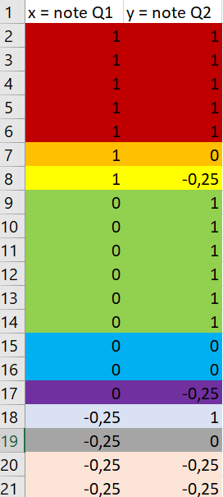
The case of two quantitatives whose data are presented in a contingency table
Introductory example:
The data
At a raw state
In a contingency table
x | y | 1 | 0 | -0.25
1 |  | 5 | 1 | 1
0 |  | 6 | 2 | 1
-0.25 |  | 1 | 1 | 2

Slide 26
Note

Slide 27
The case of two quantitatives whose data are presented in a contingency table
Introductory example:
The data
x | Nb of students
1
0
-0.25
x | y | 1 | 0 | -0.25
1 |  | 5 | 1 | 1
0 |  | 6 | 2 | 1
-0.25 |  | 1 | 1 | 2
y | Nb of students
1
0
-0.25

Slide 28
Note

Slide 29


The case of two quantitatives whose data are presented in a contingency table
Introductory example:
The data
x | Nb of students
1 | 7
0 | 9
-0.25 | 4
$$\overline{x}= ??$$
$${ s}_{x}= ??$$
y | Nb of students
1 | 12
0 | 4
-0.25 | 4
$$\overline{y}= ??$$
$${ s}_{y}= ??$$

Slide 30
Note

Slide 31
Note

Slide 32

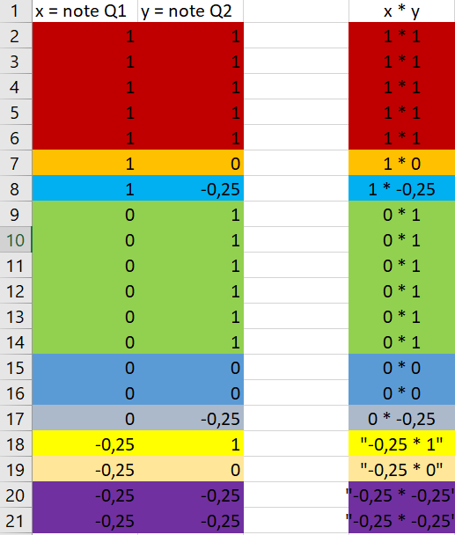

The case of two quantitatives whose data are presented in a contingency table
Introductory example:
Calculation of covariance
= ??
The covariance :
= ??

Slide 33
Note

Slide 34
The case of two quantitatives whose data are presented in a contingency table
Introductory example:
Calculation and interpretition of the linear correlation coefficient
= ??

Slide 35
Note

